Slide 1
NFE Circuit Meeting 19 June 2023
ECO SLOT (10 mins)

Slide 2
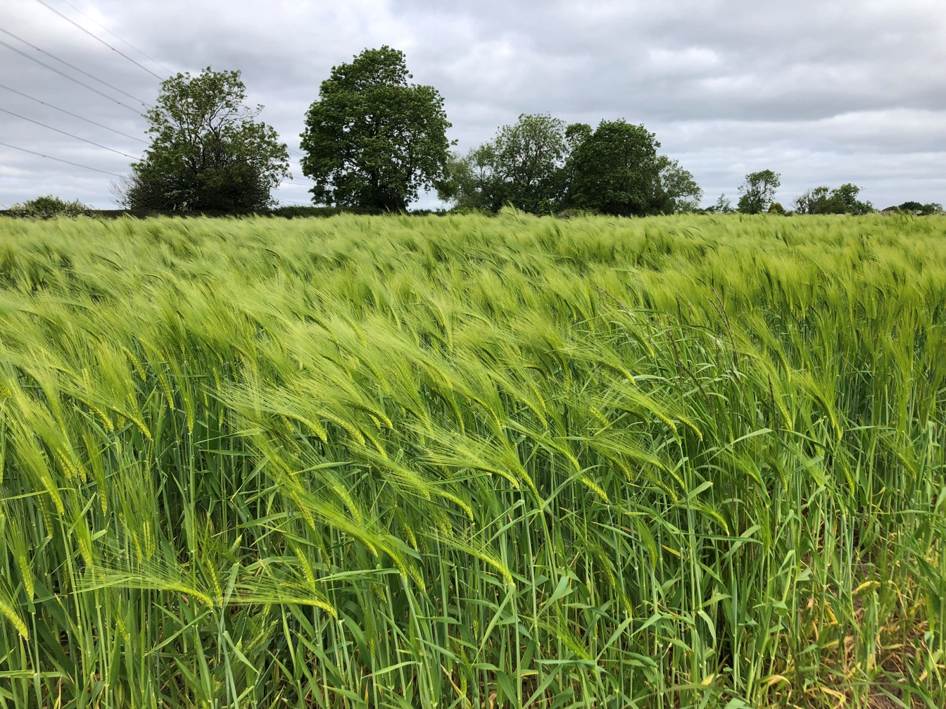

Slide 3
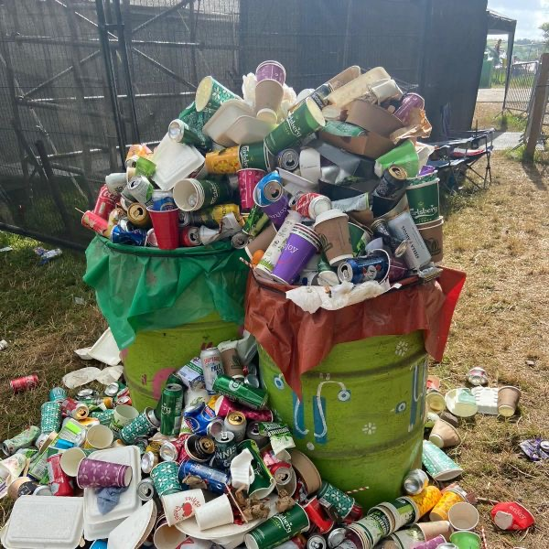

Slide 4
Reduce
Reuse
Recycle

Slide 5
Hall Lane EcoGroup
“Born” out of Property Committee
Affiliated to
(gained “Bronze” Award in 2021)
Accountable to Church Council

Slide 6
A Rocha Five Key Areas
Worship & Teaching
Building
Land
Community & Global Engagement
Lifestyle

Slide 7
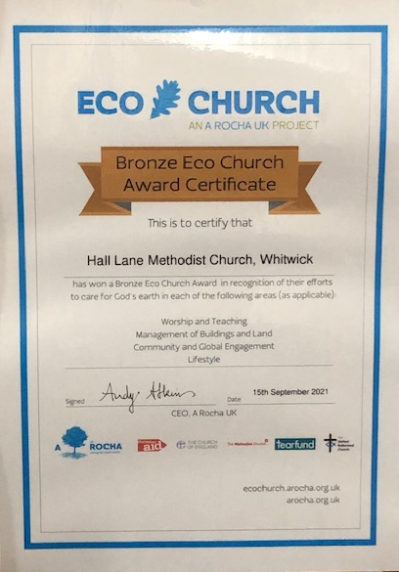

Slide 8
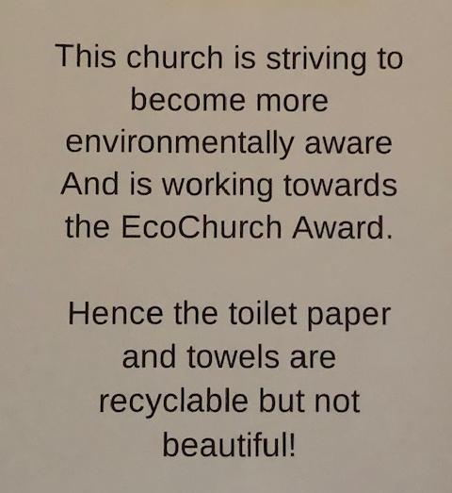
St Michael & All Angels
Fenny Drayton

Slide 9
Two designated Sundays/year
“EcoSunday”
(UN World Environment Day 5 June)
“Harvest Festival”
(Autumn)

Slide 10
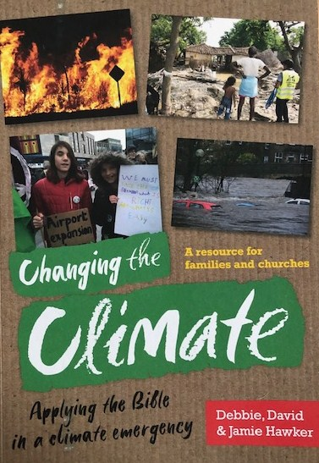

Slide 11
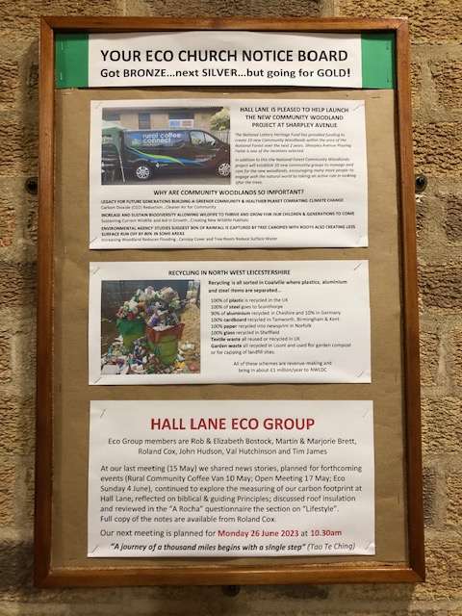

Slide 12
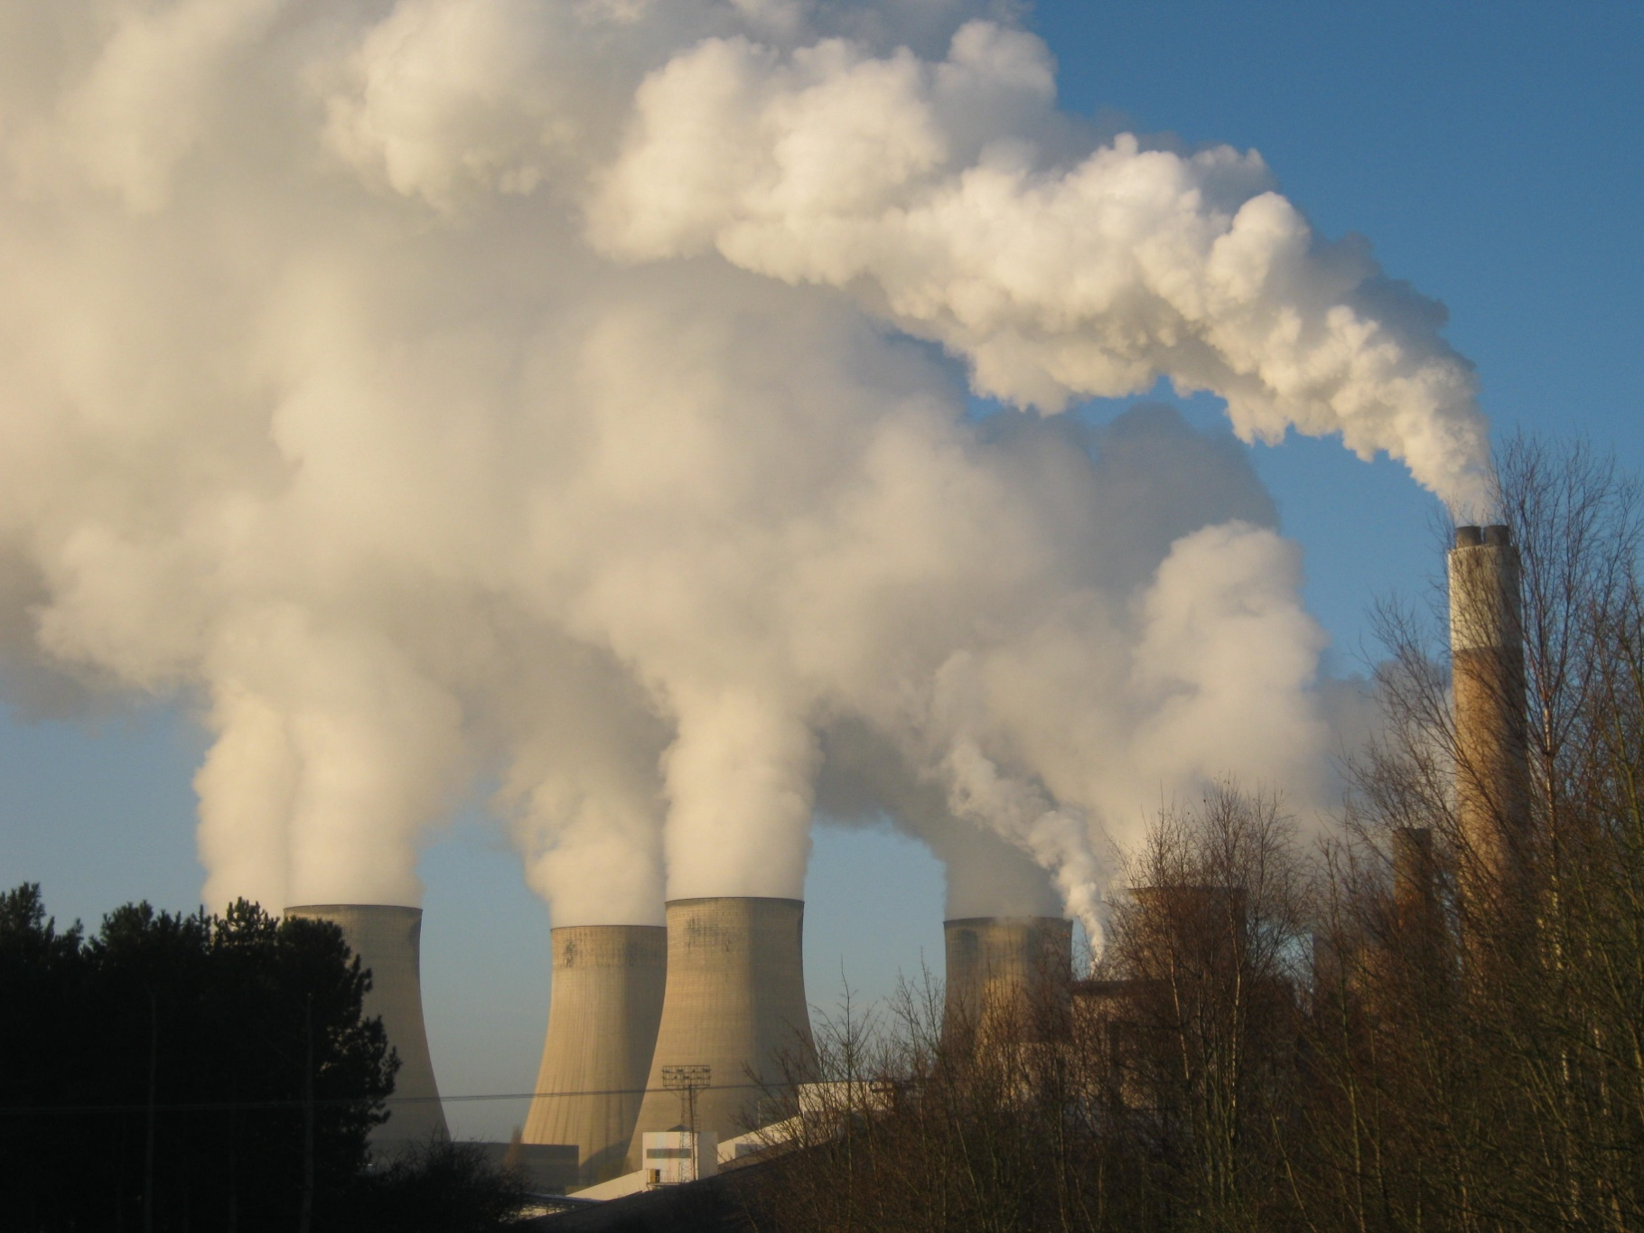

Slide 13
Targets for Net Zero
Carbon Footprint
UN & UK Government 2050
NWLDC 2045
Methodist Church 2030

Slide 14
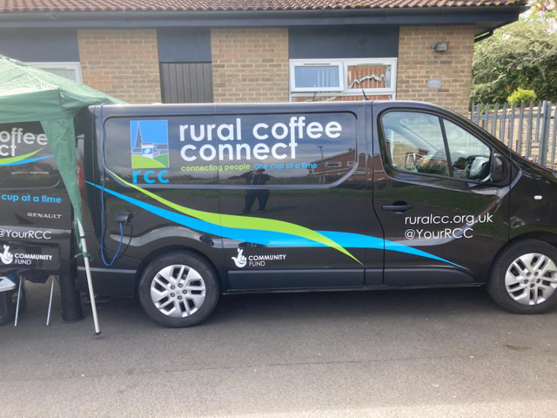

Slide 15
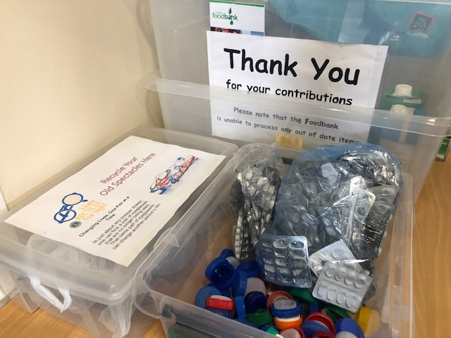

Slide 16
Our ultimate aim is
to be good stewards of what God has provided
and save the planet for future generations
Our ‘motto’ is
“a journey of a thousand miles
begins with a single step”

Slide 17
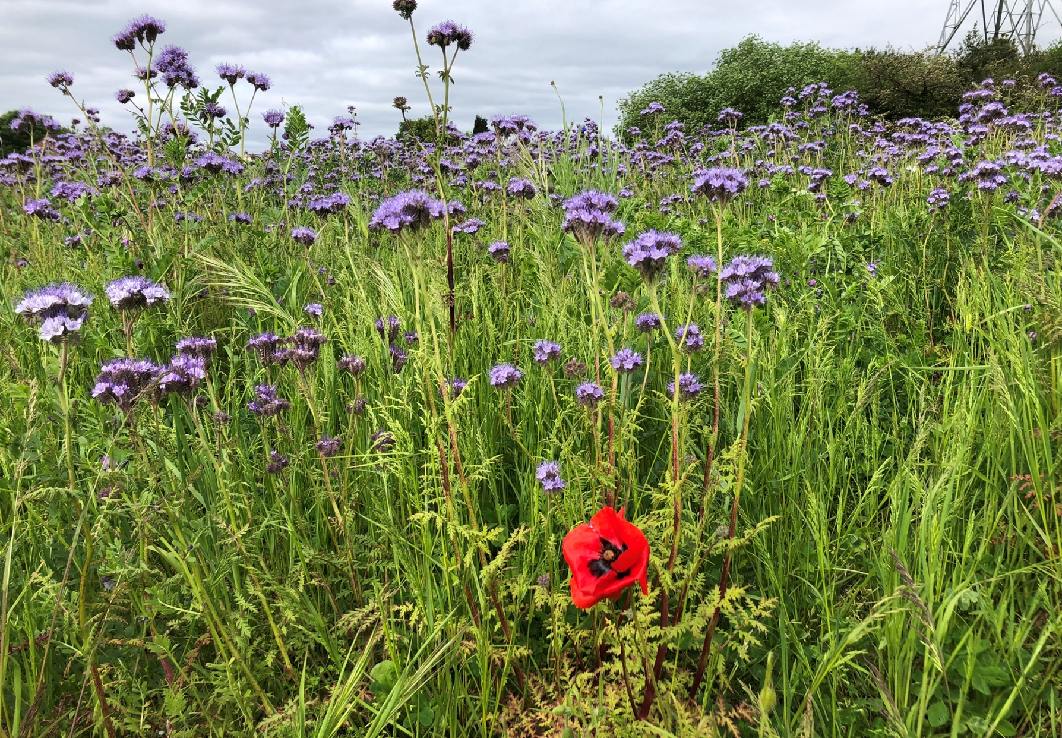
One can make a difference!

