Slide 1

National Forest East
Methodist Circuit Meeting
Growing disciples with deep roots in Jesus
Thursday 4th June, 2026

Slide 2
National Forest East Methodist Circuit Meeting
Welcome and Devotions
Reading Acts 1:12-17, 21-26

Slide 3
National Forest East Methodist Circuit Meeting
Proposal for an
Organisational Restructure of the Churches
in the National Forest East Methodist Circuit
This proposal has been put together by
the Circuit Leadership Team with support
from various experienced Methodist Church Members
from across the Circuit and
from the wider Methodist Connexion

Slide 4
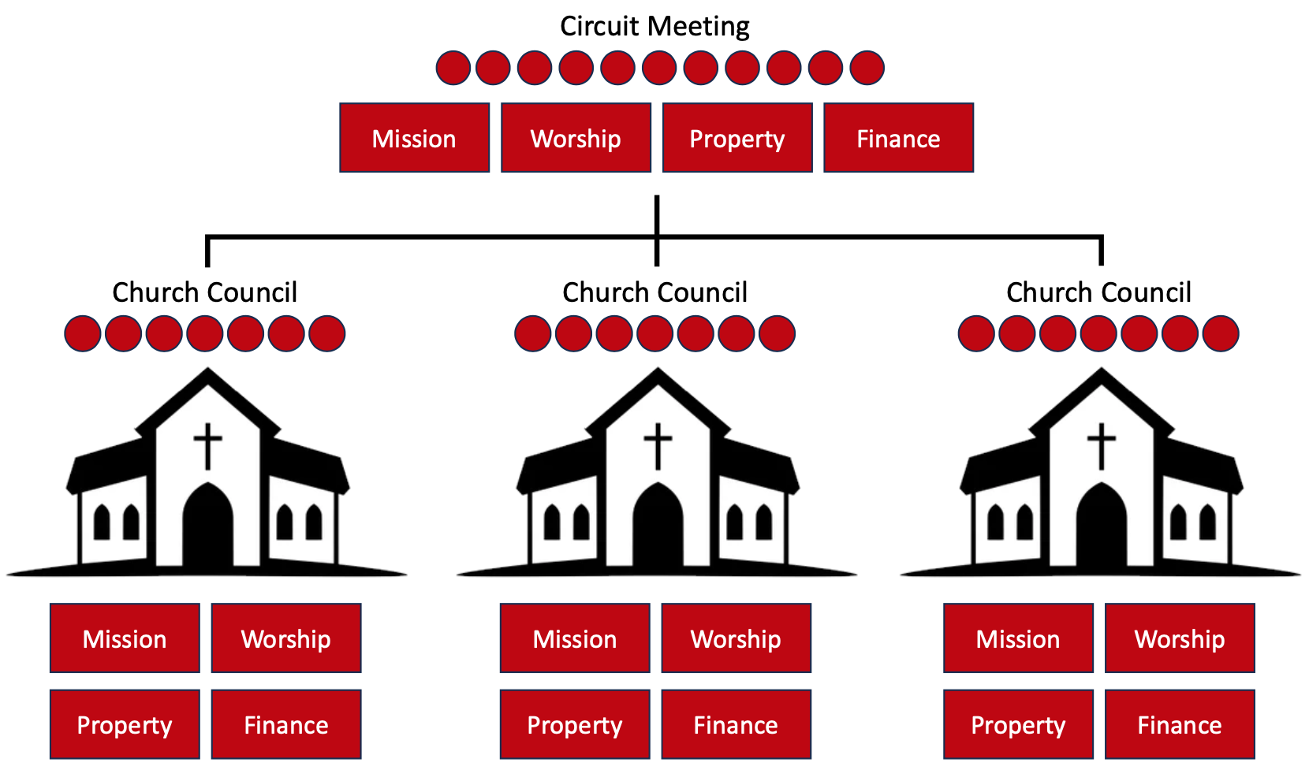
National Forest East Methodist Circuit Meeting
Current Circuit Situation

Slide 5
National Forest East Methodist Circuit Meeting
Current Circuit Situation
This has always meant
Multiple roles to be filled in each church
Multiple Church Council meetings
Inevitable focus on Property and Finance
Ministers time cannot be focussed on mission
Churches planning in isolation

Slide 6
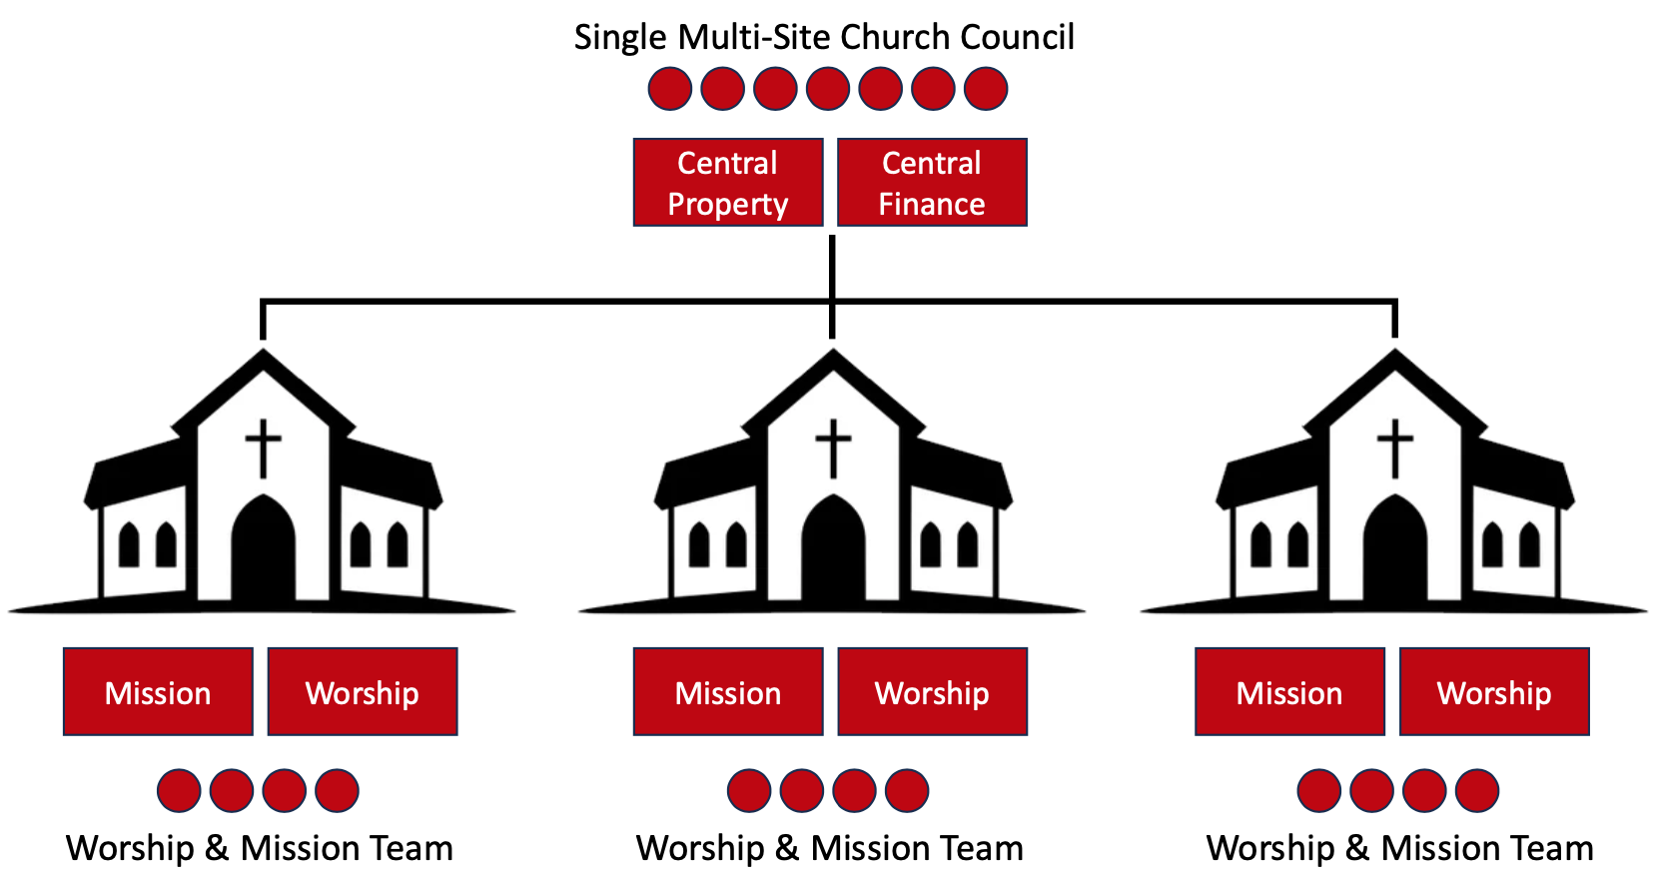
National Forest East Methodist Circuit Meeting
Alternative Multi Site Church – Long Term

Slide 7
National Forest East Methodist Circuit Meeting
Improvement possibilities
It could now be possible to have
One person managing finance process for all churches
One person managing property process for all churches
One multi-site Church Council meeting
More time to plan mission and worship in each church
Ministers with more time to support church mission
Churches planning together

Slide 8

Multi Site Church – Transition
Multi Site Church Council
Reporting to Central Finance & Property
Central Property
Central Finance
Mission
Worship
Mission
Worship
Mission
Worship
Church Council
Church Council
Worship & Mission Team
Worship & Mission Team
Worship & Mission Team
Mission
Worship
Mission
Worship
Mission
Worship
Mission
Worship
Mission
Worship
Property
Finance
Property
Finance
Worship & Mission Team
Worship & Mission Team
Worship & Mission Team

Slide 9
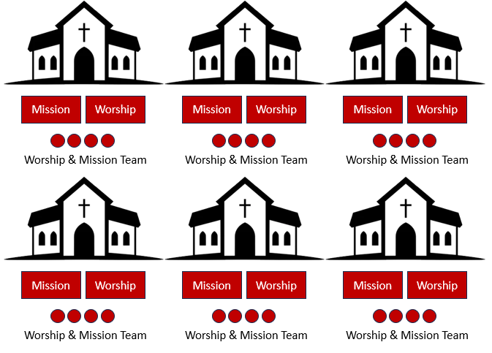
Circuit Meeting – Transition
Circuit Meeting
Mission
Worship
Central
Property
Central
Finance
Multi-Site Church Council
Church Council
Church Council
Mission
Worship
Mission
Worship
Property
Finance
Property
Finance

Slide 10
Multi Site Church (North & South) – Transition
Circuit Meeting
Central Finance
Central Property
Multi-Site Church Council (North)
Church Council
Multi-Site Church Council (South)
Church Council
Mission
Worship
Mission
Worship
Property
Finance
Property
Finance

Slide 11
National Forest East Methodist Circuit Meeting
Timescales
Tonight
Explain the concept and potential advantages
Collect responses, questions and concerns from churches
Confirm detailed proposal - but changes still possible
Before next meeting
September
Circuit Mtg

Slide 12
National Forest East Methodist Circuit Meeting
Timescales
Autumn
Ch. Councils
Ministers present proposals and feedback
Deadline for churches to decide on taking up option
Preparation of formal changeover for churches taking up option
28th February
2027
March to Sept 2027

Slide 13
National Forest East Methodist Circuit Meeting
Timescales
Church Year 2027 - 2028
First two multi-site Church Councils planned – with relevant representation appointed to the Circuit Meeting

Slide 14
National Forest East Methodist Circuit Meeting
Circuit Staffing
Lay Pastor to help churches focus on growing new disciples work.
Finance Co-Ordinator to release local people for mission: functioning as Circuit treasurer and Church treasurer for some churches
(est. 10 hrs pw potentially rising to 15hrs pw)

Slide 15
National Forest East Methodist Circuit Meeting
Circuit Staffing
Admin support – need to review role of Cct Office
Property Officer – continuing central support
Safeguarding continuing co-ordination from Circuit

Slide 16
National Forest East Methodist Circuit Meeting
Circuit Staffing
  f) Ministers’ stations
Rev Phil
Superintendency
Ashby
Hall Lane
Hugglescote
Marlborough Square
Moira
Whitwick
Rev Nikki
Castle Donnington
MMC@Melbourne
MMC@Weston
New Sawley
Sutton Bonington

Slide 17
National Forest East Methodist Circuit Meeting
Churches and Congregations…
What constitutes growth?
When is enough enough with old buildings?
Discerning when it’s time to cease,
and help to do that as well as possible.

Slide 18
National Forest East Methodist Circuit Meeting
Before September meeting
Collect responses, questions
and concerns from churches

Slide 19
National Forest East Methodist Circuit Meeting
September Circuit Mtg
Confirm detailed proposal –
but changes still possible

